Slide 1
Data Driven AI
Week 8 - Neural Network Models
Dr. Abirami Gunasekaran
CHS2406: Data-driven AI

Slide 2
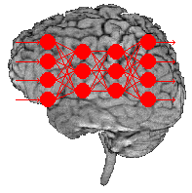
Topics Covered
Neural Network(NN) Terminologies
NN working principle and their design issues
Handling Overfitting
Backpropagation algorithm with an example
Creating a NN using TensorFlow and Keras

Slide 3
Terminologies in Artificial Neural Network

Slide 4
Terminologies in Artificial Neural Network
Nodes/Neurons

Slide 5
Connections

Slide 6
Weights/Synapses
^{W}11
^{W}12
.
.
^{V}11
^{V}12
.
.
^{W}34
^{V}42

Slide 7
Input Layer

Slide 8
Output Layer

Slide 9
Hidden Layer

Slide 10
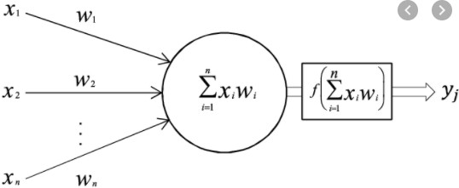
i₁
^{W}11
x₁
^{W}21
^{W}31
y₁
i₂
h₁
x₂
y₂
i₃
x₃
Perceptron
Input Layer
Hidden Layer
Output Layer

Slide 11
i₁
^{W}11
x₁
^{W}21
^{W}31
y₁
i₂
h₁
x₂
y₂
i₃
x₃
Perceptron
Activation
Function
Input Layer
Hidden Layer
Output Layer

Slide 12
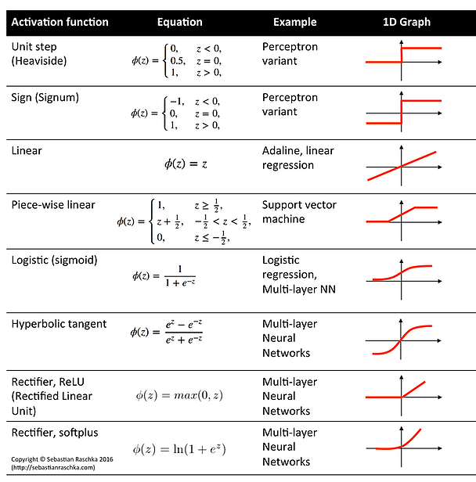
Activation Functions

Slide 13



Activation Functions

Slide 14
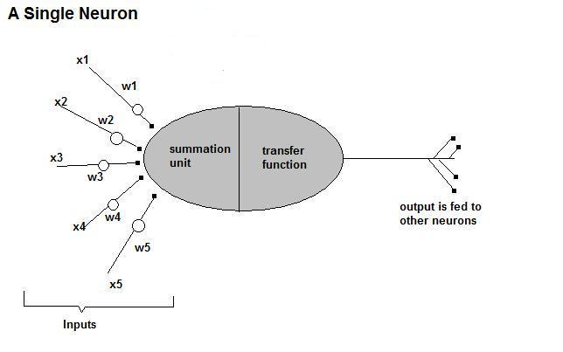
How do ANNs work?
• Now, let us have a look at the model of an artificial neuron.

Slide 15
How do ANNs work?
Input
xm
. . . . . . . . . . . .
x2
x1
Processing
∑
∑= X₁+X₂ + ….+X_{m} =y
Output
y

Slide 16
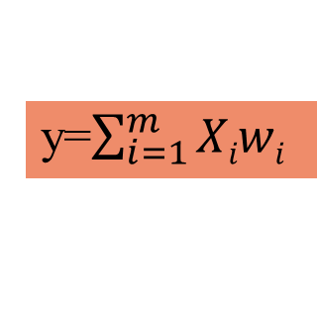
How do ANNs work?
xm
. . . . . . . . . . . .
x2
x1
Input
w_{m}
w₂
w₁
weights
. . . . .
Processing
∑
∑ X₁w₁+X₂w₂ + ….+X_{m}w_{m}=y
Output
y
y=$\sum_{i=1}^{m}{Xiwi}$

Slide 17
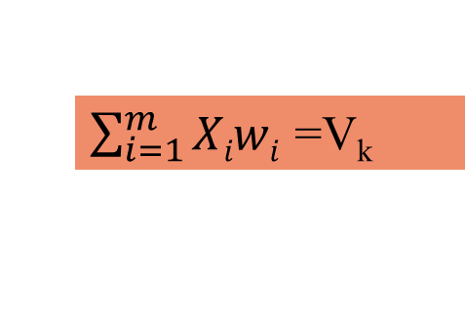
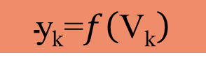
How do ANNs work?
xm
. . . . . . . . . . . .
x2
x1
Input
w_{m}
w₂
w₁
weights
. . . . .
Processing
∑
$\sum_{i=1}^{m}{Xiwi}$ =V_{k}
Transfer Function (Activation Function)
f(v_{k})
$$\text{y}\text{k}\text{=}f\left(\text{V}\text{k}\right)$$
Output
y

Slide 18
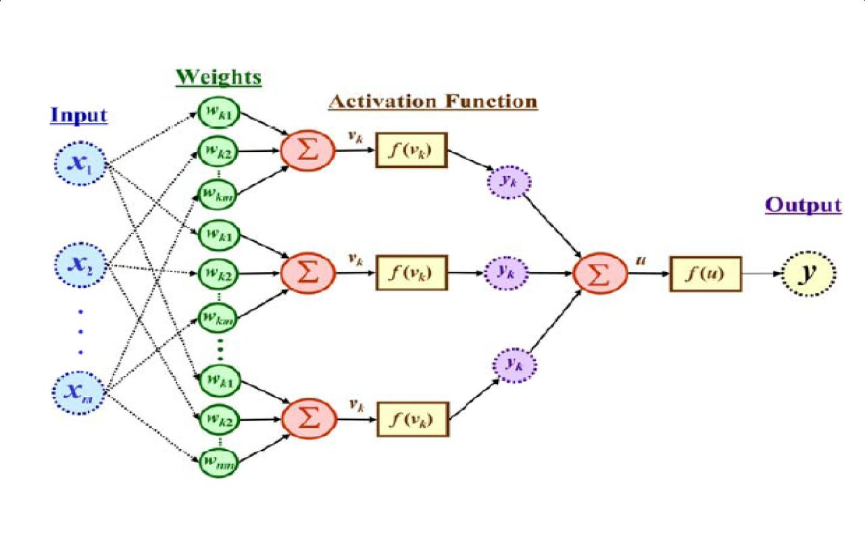
The output is a function of the input, that is affected by the weights, and the transfer functions

Slide 19
Learning Paradigms
Supervised learning
Unsupervised learning
Reinforcement learning

Slide 20
Supervised learning
This is what we have seen so far!
A network is fed with a set of training samples (inputs and corresponding output), and it uses these samples to learn the general relationship between the inputs and the outputs.
This relationship is represented by the values of the weights of the trained network.

Slide 21
Unsupervised learning
No desired output is associated with the training data!
Faster than supervised learning
Used to find out structures within data:
E.g. Clustering

Slide 22
Reinforcement learning
Like supervised learning, but:
Weight adjusting is not directly related to the error value.
The error value is used to randomly, shuffle weights!
Relatively slow learning due to ‘randomness’.

Slide 23
Design Issues
Initial weights (small random values ∈[‐1,1])
Activation function (How the inputs and the weights are combined to produce output?)
Number of neurons
Size of training set
Error & Performance metrics
Weights adjusting

Slide 24
Activation Functions
Linear: The output is proportional to the total weighted input.
Threshold: The output is set at one of two values, depending on whether the total weighted input is greater than or less than some threshold value.
Non‐linear: The output varies continuously but not linearly as the input changes.

Slide 25
Performance Metrics
The performance metrics depend on the task type, such as regression, classification, or other specialised tasks.
Classification Task:
For Balanced Datasets: Accuracy is often sufficient.
For Imbalanced Datasets: Metrics like F1 Score, Precision-Recall curves, or AUC-ROC are more informative.
For Multi-Class Classification: Top-k Accuracy, Confusion Matrix, and Macro/Micro Averaged F1 Score.
For Confidence Evaluation: Log Loss or Cross-Entropy is a good choice.
Regression Task:
Mean Absolute Error (MAE), Mean Squared Error (MSE), Root Mean Squared Error (RMSE) and R-Squared (Coefficient of Determination)

Slide 26
Loss Functions
Quantifies how well or poorly the model's predictions match the actual target values.
Goal of training is to minimise this loss
Classification Task:
Categorical Cross entropy: Used for multi-class classification problems
(e.g., loss='categorical_crossentropy').
Binary Cross entropy: Used for binary classification problems (e.g., loss='binary_crossentropy').
Regression Task:
Mean Squared Error (MSE): Often used for continuous output values
(e.g., loss='mean_squared_error').

Slide 27
Size of training set
No one‐size-fits‐all formula
Over fitting can occur if a “good” training set is not chosen
What constitutes a “good” training set?
Samples must represent the general population.
Samples must contain members of each class.
Samples in each class must contain a wide range of variations or noise effect.
The number of hidden layer neurons is related to the size of the training set

Slide 28
Number of Neurons
If you choose,
Many neurons:
Higher accuracy
Slower
Risk of over‐fitting
Memorising, rather than understanding
The network will be useless with new problems.
Few neurons:
Lower accuracy
Inability to learn at all
Should be an Optimal number

Slide 29
Weights Adjusting
After each iteration, weights should be adjusted to minimise the error.
– All possible weight adjustments
Back propagation

Slide 30
Back Propagation
Back-propagation, an example of supervised learning, is used at each layer to minimise the error between the layer’s response and the actual data
The error at each hidden layer is an average of the evaluated error
Hidden layer networks are trained in this way

Slide 31
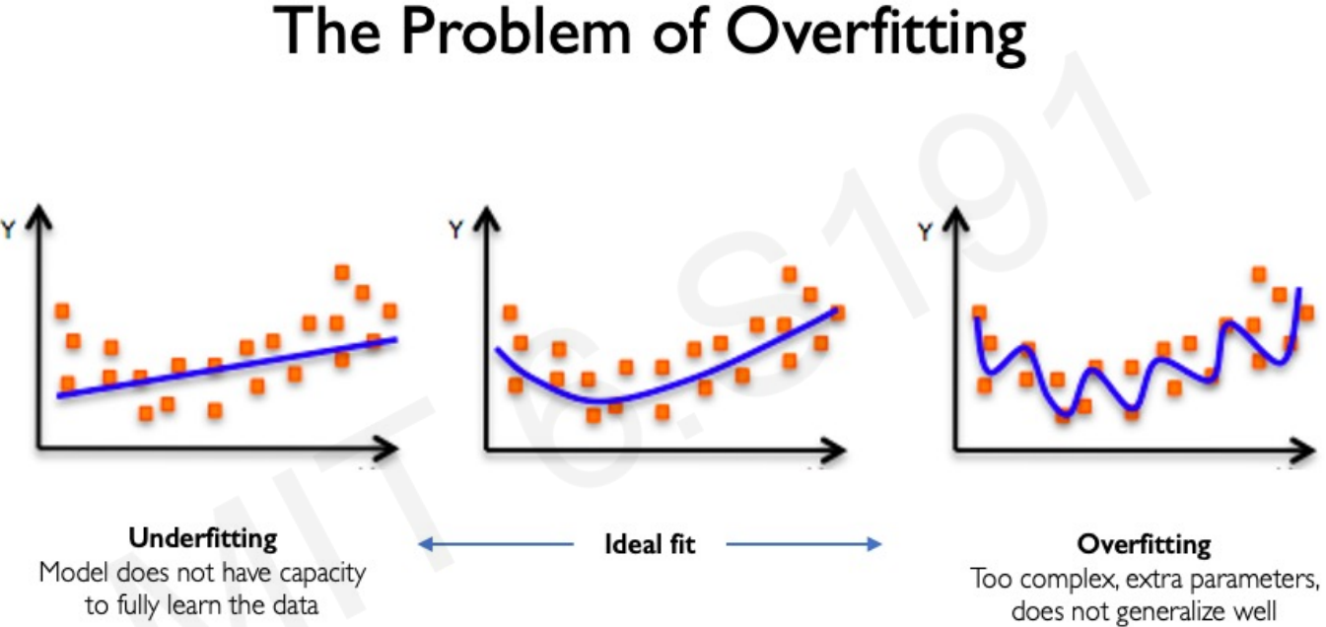
Neural Networks in Practice

Slide 32
Regularization
What is it?
Technique that constrains our optimisation problem to discourage complex models
Why do we need it?
Improve generalisation of our model on unseen data

Slide 33
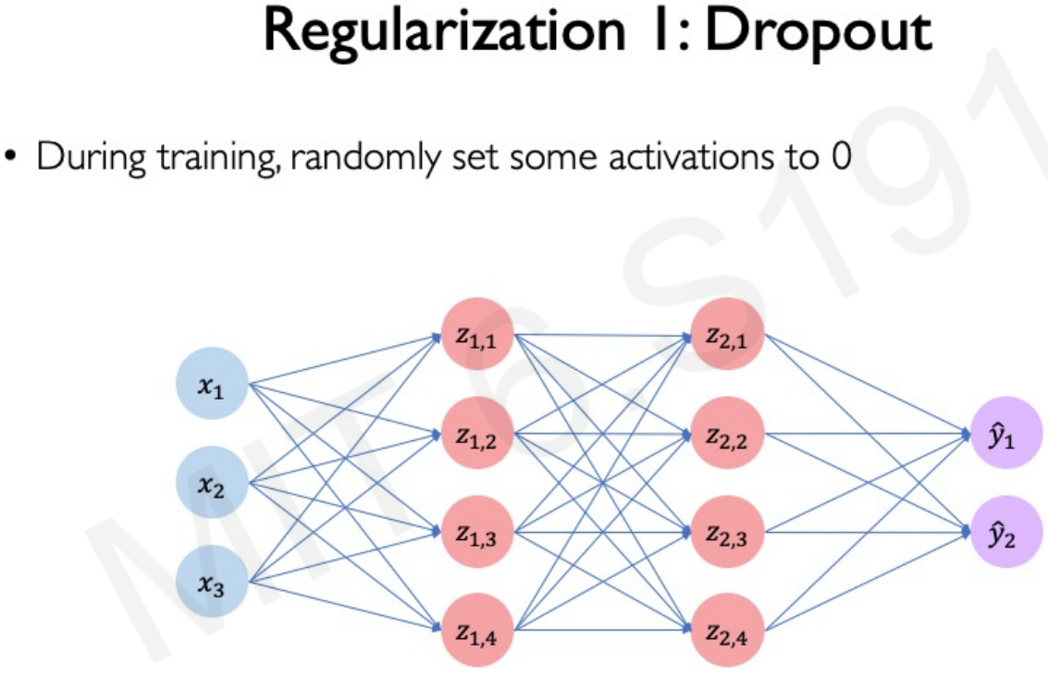

Slide 34
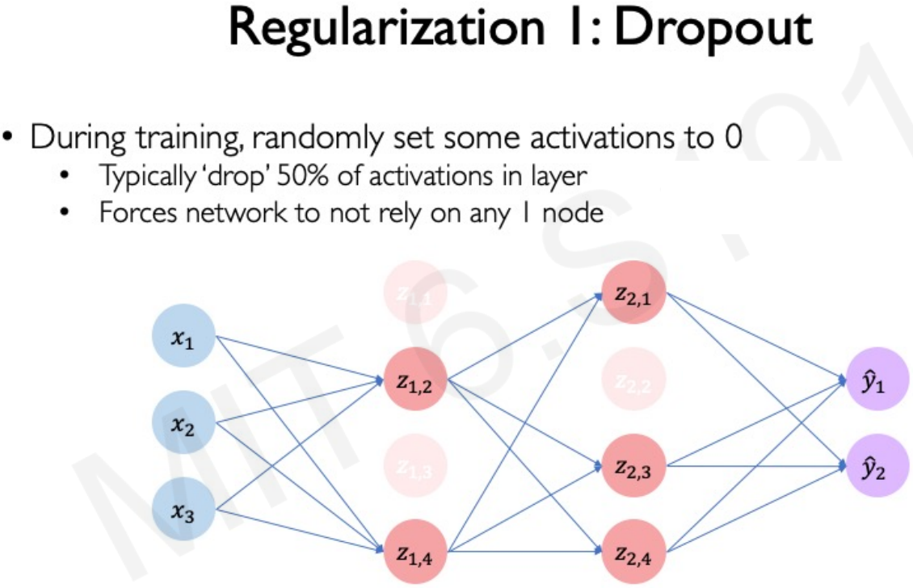

Slide 35
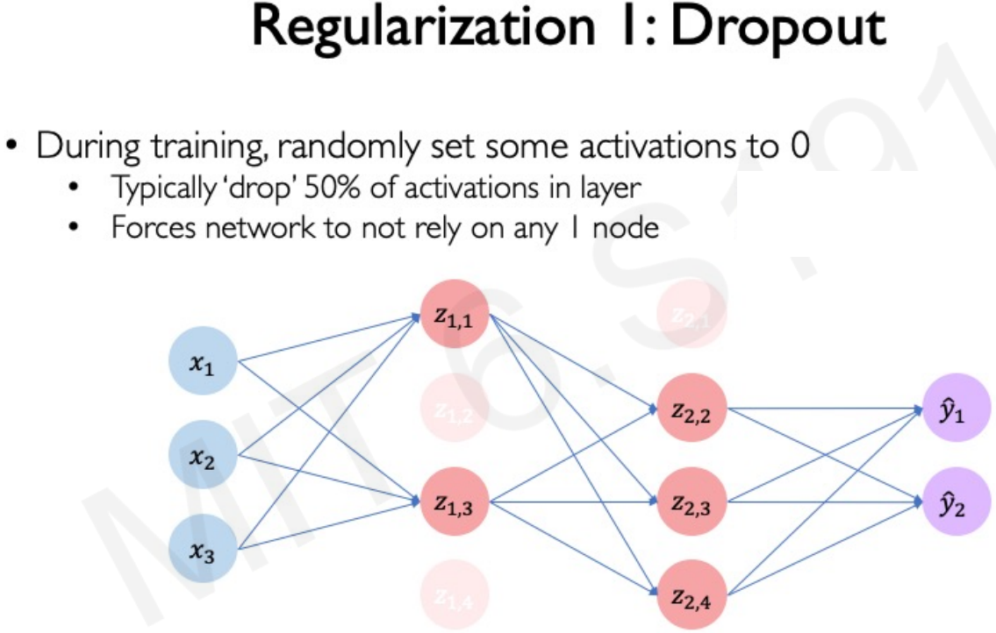

Slide 36
Sample Code - Dropout
from keras.models import Sequential
from keras.layers import Dense, Dropout
model = Sequential()
model.add(Dense(64, activation='relu', input_dim=100))
model.add(Dropout(0.5)) # 50% dropout rate
model.add(Dense(64, activation='relu'))
model.add(Dropout(0.25))
model.add(Dense(10, activation='softmax’))

Slide 37
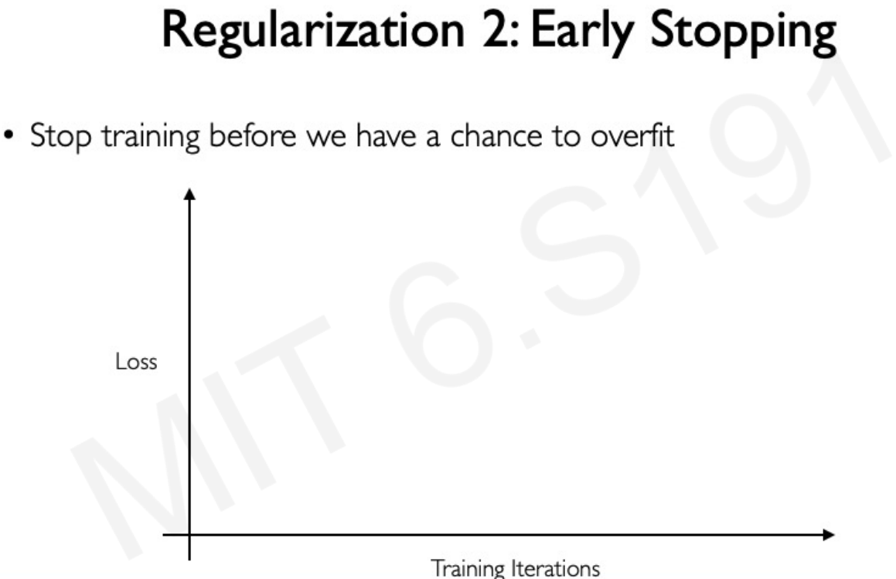

Slide 38
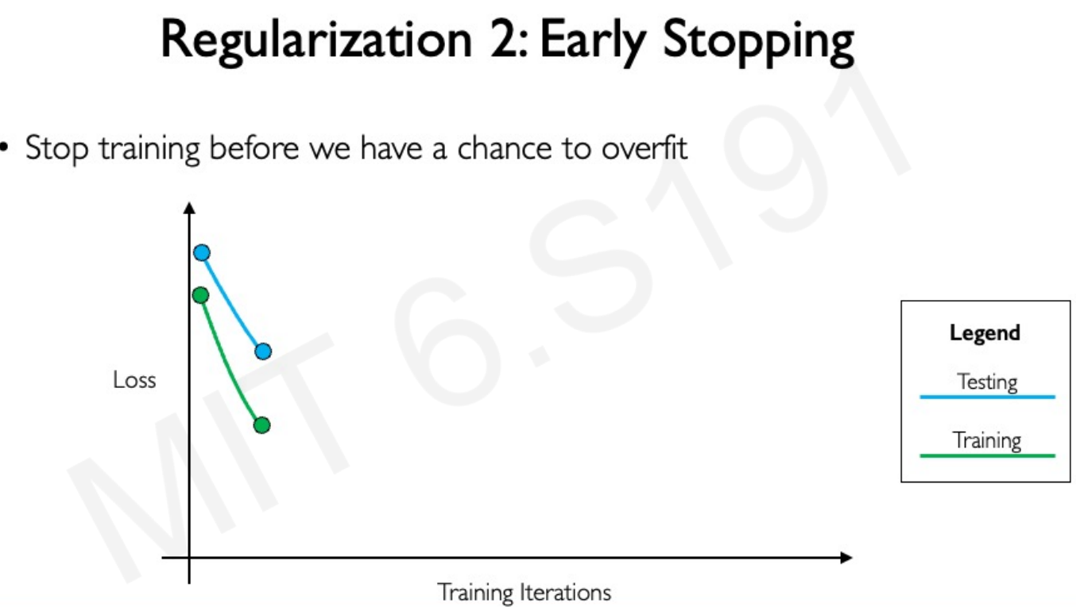

Slide 39
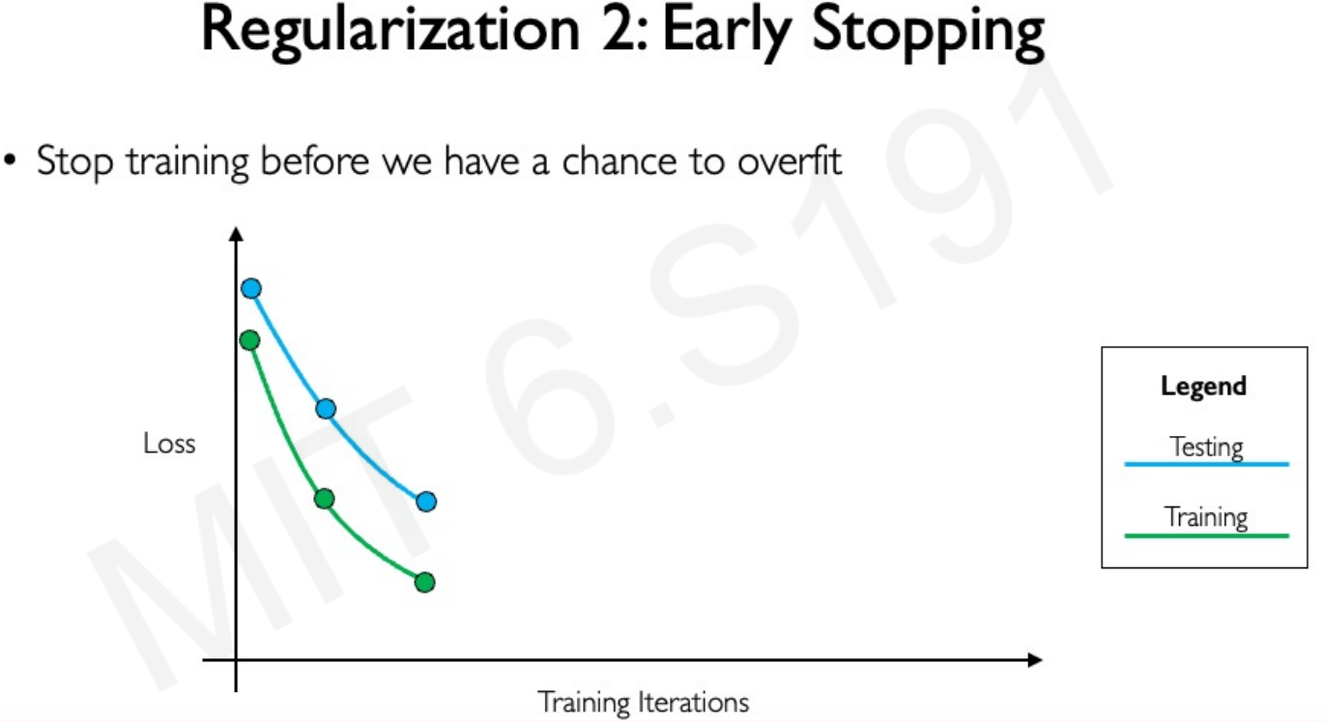

Slide 40
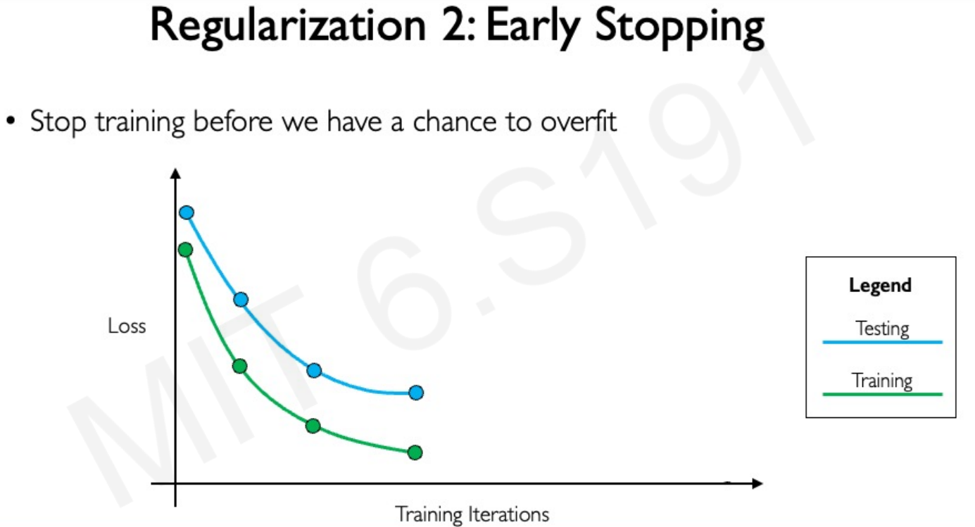

Slide 41
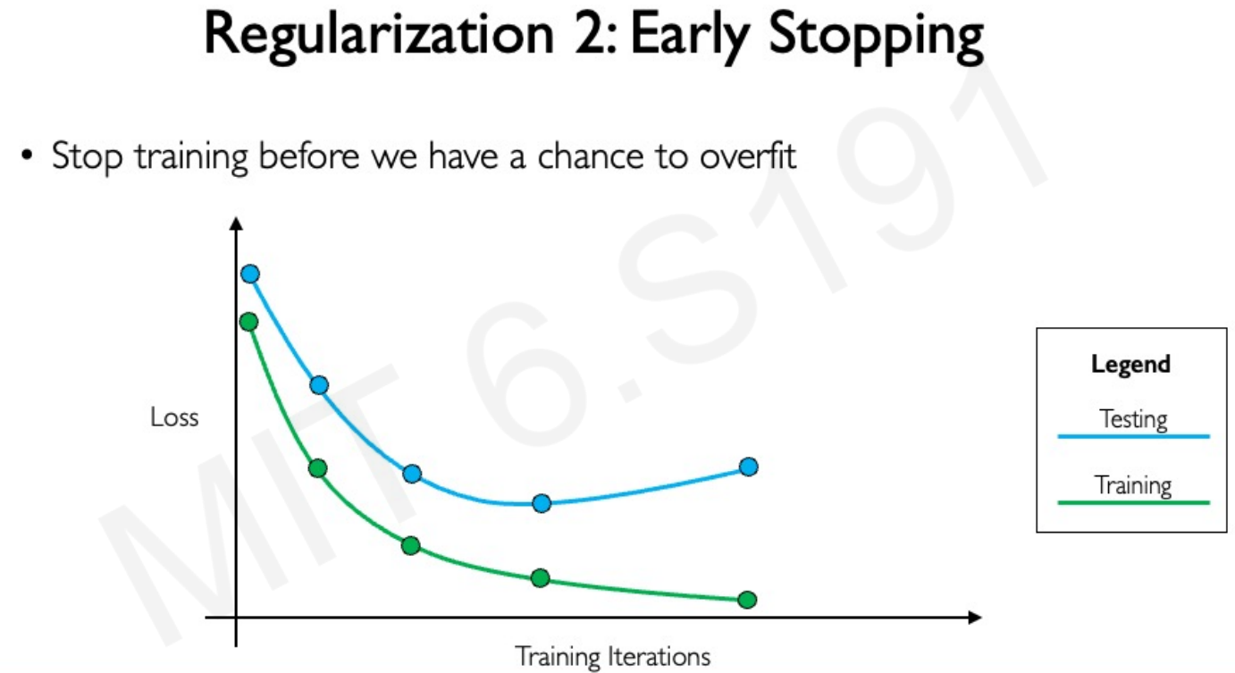

Slide 42
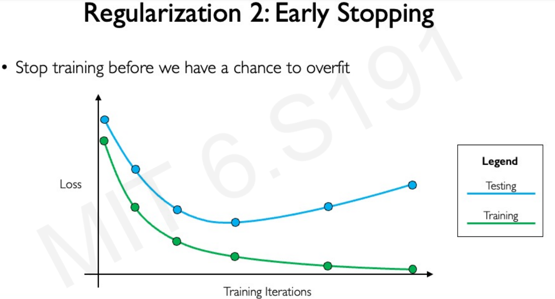

Slide 43
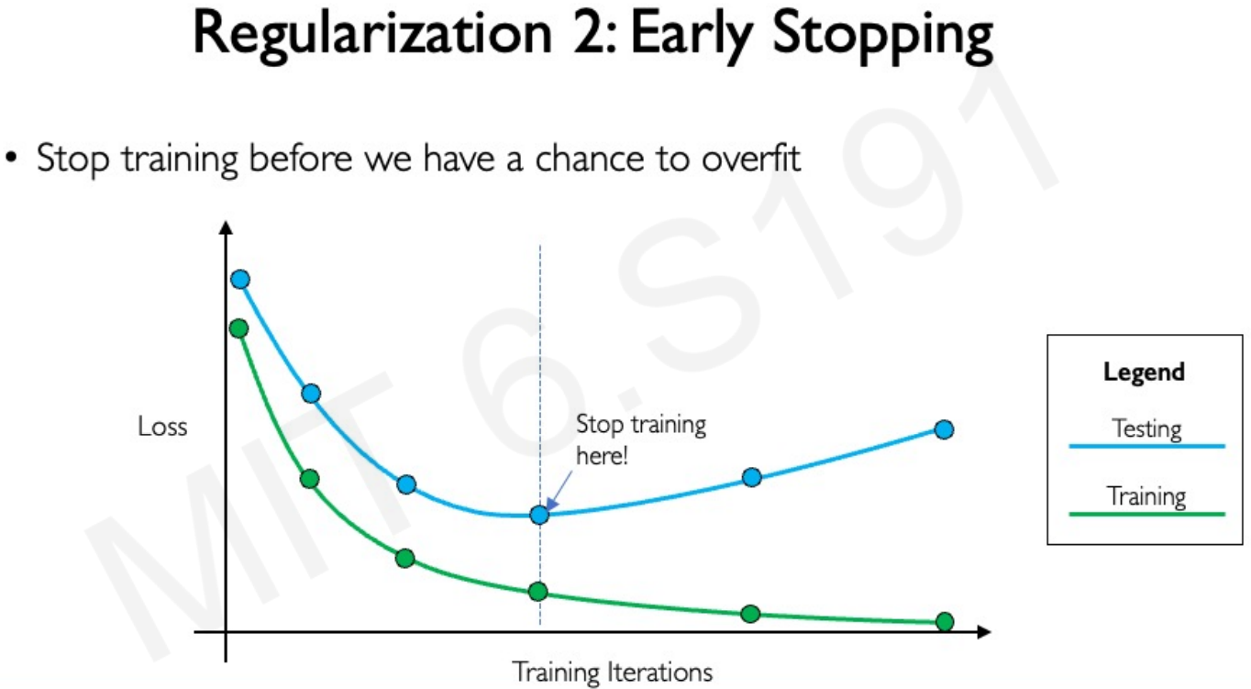

Slide 44
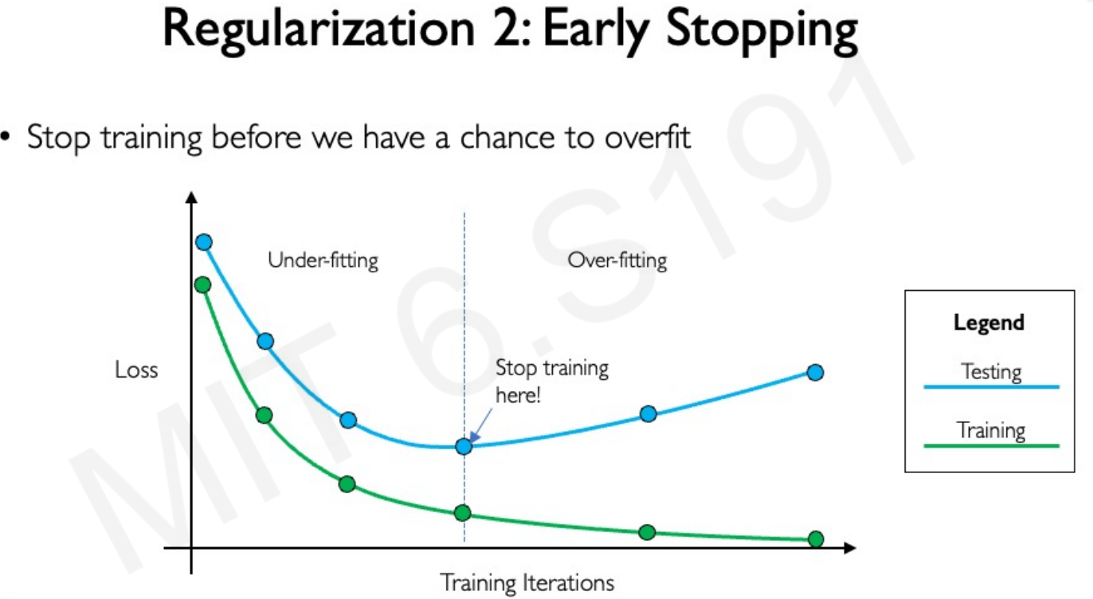

Slide 45
Sample Code - Earlystopping
from keras.callbacks import EarlyStopping
early_stopping = EarlyStopping(monitor='val_loss', patience=5,
restore_best_weights=True)
model.fit(x_train, y_train, epochs=100,
validation_data=(x_val,y_val), callbacks=[early_stopping])

Slide 46
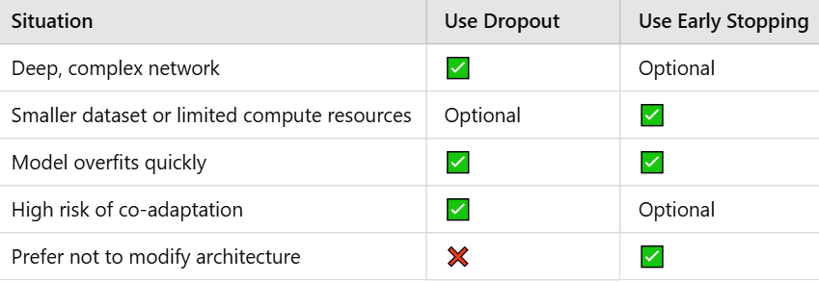
When to choose which Regularisation

Slide 47
Training a Neural Network
(“Forward propagation”)
Assume a two-layer networks (i.e., one hidden layer):
Present input to the input layer.
Forward propagate the activations times the weights to each node in the hidden layer.
Apply activation function (sigmoid) to sum of weights times inputs
to each hidden unit.
Forward propagate the activations times weights from the hidden layer to the output layer.
Apply activation function (sigmoid) to sum of weights times inputs
to each output unit.
Interpret the output layer as a classification.
At each output unit, determine the error.
Run the back-propagation algorithm one layer at a time to update all weights in the network.
Repeat steps 2 to 8 for a given number of epochs or until accuracy on training data is acceptable.

Slide 48
Backpropagation algorithm
(Stochastic Gradient Descent)
Initialize the network weights w to small random numbers (e.g.,
between −0.05 and 0.05).
Until the termination condition is met, Do:
For each (x,t) ∈ training set, Do:
Propagate the input forward:
Input x to the network and compute the activation h_{j} of
each hidden unit j.
Compute the activation o_{k} of each output unit k.

Slide 49
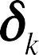
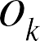
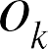
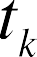

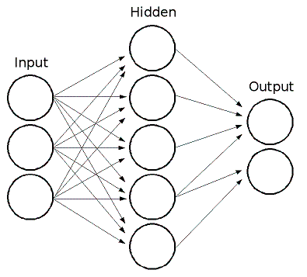
2. Calculate error terms
For each output unit k, calculate error term δ_{k} :
For each hidden unit j, calculate error term δ_{j} :
⎛ ⎞
δ_{j} ← h_{j} (1− h_{j} )⎜
∑
^{w}kj ^{δ}k ⎟
⎝k∈output units
⎠

Slide 50


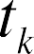
2. Calculate error terms
For each output unit k, calculate error term δ_{k} :
For each hidden unit j, calculate error term δ_{j} :
⎛ ⎞
δ_{j} ← h_{j} (1− h_{j} )⎜
∑
^{w}kj ^{δ}k ⎟
⎝k∈output units
⎠

Slide 51
3. Update weights
Hidden to Output layer: For each weight w_{kj}
w_{kj} ← w_{kj} + Δw_{kj}
where
Δw_{kj} = ηδ_{k}h_{j}
Input to Hidden layer: For each weight w_{ji}
w_{ji} ← w_{ji} + Δw_{ji}
where
Δw_{ji} = ηδ_{j} x_{i}

Slide 52





Backpropagation Algorithm (BP)
– Forward Pass: compute the activation of each neuron in the hidden layers and outputs using:
⎛ ⎞
⎛ ⎞
h_{j} = σ ⎜
∑
o_{k} = σ ⎜
∑
^{w}kj^{h}j ^{+ w}k 0 ⎟
^{w}ji ^{x}i ^{+ w}j 0 ⎟
⎝i ∈ input layer ⎠
⎝ j ∈ hidden layer
⎠
Backward pass
Compute the error at the output using:
⎛
⎞
– Compute the error at the hidden layer(s) using: δ_{j} ← h_{j} (1− h_{j} )⎜
∑
^{w}kj ^{δ}k ⎟
⎝k∈output units
⎠
– Update the output layer weights using: w_{kj} ← w_{kj} + Δw_{kj}
where
Δw_{kj} = ηδ_{k}h_{j}
Update the hidden layer weights using: w_{ji} ← w_{ji} + Δw_{ji}
where Δw_{ji} = ηδ_{j} x_{i}
(If using sequential updating) randomize the order of the input vectors so that you don’t train in exactly the same order each iteration.

Slide 53

Backpropagation Example

Slide 54
Training set:
1 0
0 1
Test set:
1
Label: 0.9
1
Label: .8
Label: -.3
o₁
.1
.1
.1
1
h₁
h₂
.1
.1
.1
.1
.1
.1
1
x₁
x₂

Slide 55
Training set:
1 0
0 1
Test set:
1
Label: .9
1
Label: .8
Label: -.3
Target: .9
o₁
.1
.1
.1
1
h₁
h₂
.1
.1
.1
.1
.1
.1
1
x₁
1
x₂
0

Slide 56

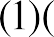
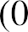
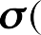
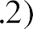


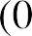
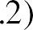
Training set:
1 0
0 1
Test set:
1
Label: .9
1
Label: .8
Label: -.3
Target: .9
o₁
.1
.1
.1
1
h₁
h₂
.1
.1
.1
.1
.1
.1
1
x₁
1
x₂
0

Slide 57
Training set:
1 0
0 1
Test set:
1
Label: .9
1
Label: .8
Label: -.3
Target: .9
o₁
.1
.1
.1
1
.55
.55
.1
.1
.1
.1
.1
.1
1
x₁
1
x₂
0
“Forward Phase” – hidden layers

Slide 58
Training set:
1 0
0 1
Test set:
1
Label: .9
1
Label: .8
Label: -.3
Target: .9
o₁
.1
.1
.1
1
.55
.55
.1
.1
.1
.1
.1
.1
1
x₁
1
x₂
0

Slide 59
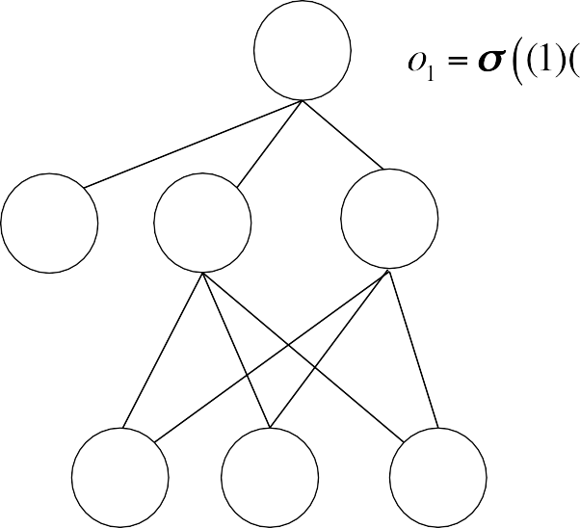
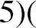
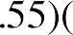
Training set:
1 0
0 1
Test set:
1
Label: .9
1
Label: .8
Label: -.3
Target: .9
o₁
.1
.1
.1
1
.55
.55
.1
.1
.1
.1
.1
.1
1
x₁
1
x₂
0
“Forward Phase” – output layer

Slide 60
Training set:
1 0
0 1
Test set:
1
Label: .9
1
Label: .8
Label: -.3
Target: .9
.552
.1
.1
.1
1
.55
.55
.1
.1
.1
.1
.1
.1
1
x₁
1
x₂
0
“Forward Phase” – output layer

Slide 61
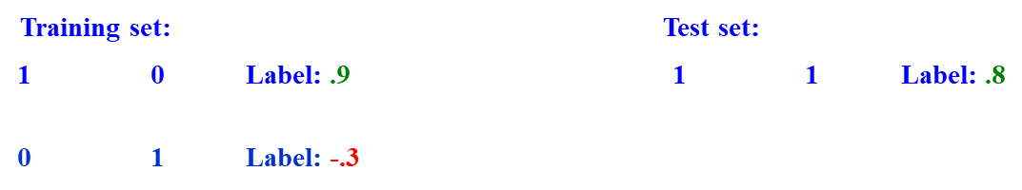

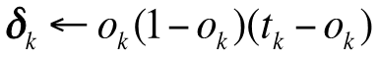
Target: .9
.552
.1
.1
.1
1
.55
.55
Output weight Updates
.1
.1
.1
.1
.1
.1
Hidden weight Updates
1
x₁
1
x₂
0
⎛
⎞
δ_{j} ← h_{j} (1− h_{j} )⎜
∑
^{w}kj ^{δ}k ⎟
⎝k∈output units
⎠
“Backward Phase”

Slide 62
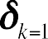
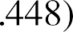
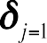
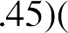
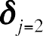
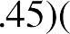
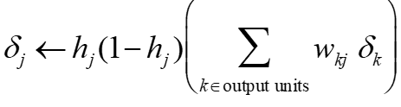
Target: .9
Calculate error terms:
.552
.1
.1
.1
1
.55
.55
.1
.1
.1
.1
.1
.1
1
x₁
1
x₂
0
“Backward Phase”
Output weight Updates
Hidden weight Updates

Slide 63
Target: .9
Calculate error terms:
.552
.1
.1
.1
1
.55
.55
.1
.1
.1
.1
.1
.1
1
x₁
1
x₂
0
“Backward Phase”
Output weight Updates
Hidden weight Updates

Slide 64
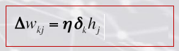
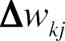
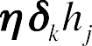
Training set:
1 0
0 1
Test set:
1
Label: Positive
1
Label: Positive
Label: Negative
Target: .9
Calculate error terms:
.552
.1
.1
.1
1
.55
.55
.1
.1
.1
.1
.1
.1
1
x₁
1
x₂
0
Update hidden-to-output weights (learning rate = 0.2):

Slide 65
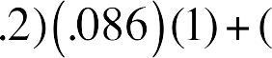
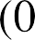




Calculate error terms:
Target: .9
.552
.1
.1
.1
1
.55
.55
.1
.1
.1
.1
.1
.1
1
x₁
1
x₂
0
Update hidden-to-output weights (learning rate = 0.2): Hidden unit j=1

Slide 66


Calculate error terms:
Target: .9
.552
.1
.1
.1
1
.55
.55
.1
.1
.1
.1
.1
.1
1
x₁
1
x₂
0
Update hidden-to-output weights (learning rate = 0.2):
_{w}1
=.1+.0172 =.1172
k=1, j=0
_{w}1
=.1+.0095 =.1095
k=1, j=1
_{w}1
=.1+.0095 =.1095
k=1, j=2

Slide 67
Calculate error terms:
Target: .9
.552
.1172
.1095
.1095
1
.55
.55
.1
.1
.1
.1
.1
.1
1
x₁
1
x₂
0
Update hidden-to-output weights (learning rate = 0.2):
_{w}1
=.1+.0172 =.1172
k=1, j=0
_{w}1
=.1+.0095 =.1095
k=1, j=1
_{w}1
=.1+.0095 =.1095
k=1, j=2

Slide 68









Target: .9
Calculate error terms:
.552
.1172
.1095
.1095
1
.55
.55
.1
.1
.1
.1
.1
.1
1
x₁
1
x₂
0
Update input-to-hidden weights (learning rate = 0.2)
_{w}1
=.1+.0004 =.1004
j=1,i=0
_{w}1
=.1+.0004 =.1004
j=1,i=1
Δw¹ = (.2)(.002)(0) +(.9)(0) = 0
_{w}1
=.1
j=1,i=2
j=1,i=2

Slide 69
Calculate error terms:
Target: .9
.552
.1172
.1095
.1095
1
.55
.55
.1
.1
.1
.1004
.1
.1004
1
x₁
1
x₂
0
Update input-to-hidden weights (learning rate = 0.2)
_{w}1
=.1+.0004 =.1004
j=1,i=0
_{w}1
=.1+.0004 =.1004
j=1,i=1
Δw¹
= (.2)(.002)(0) +(.9)(0) = 0
_{w}1
=.1
j=1,i=2
j=2,i=2

Slide 70
Target: .9
Calculate error terms:
.552
.1172
.1095
.1095
1
.55
.55
.1
.1
.1
.1004
.1
.1004
1
x₁
1
x₂
0
Update input-to-hidden weights (learning rate = 0.2): Hidden unit j=2
Δw_{j=2,i=0} = (.2)(.002)(1) +(.9)(0) =.0004
_{w}1
=.1+.0004 =.1004
j=2,i=0
Δw¹ = (.2)(.002)(1) +(.9)(0) =.0004
_{w}1
=.1+.0004 =.1004
j=2,i=1
j=2,i=1
Δw¹
= (.2)(.002)(0) +(.9)(0) = 0
_{w}1
=.1
j=2,i=2
j=2,i=2

Slide 71
Calculate error terms:
Target: .9
.552
.1172
.1095
.1095
1
.55
.55
.1 .1004
.1
.1004
.1004
.1004
1
x₁
1
x₂
0

Slide 72
Training Time
Continue the forward pass training
Estimate the error and backpropagate the adjustments
Repeat these processes for a given number of epochs or until accuracy on training data is acceptable.
The Aim is to balance between Generalisation & Memorisation
( Minimising cost function is not necessarily good idea ).
As long as the error for the training-testing set decreases, training continues (unless max # iterations achieved).
When the error begins to increase , the net is starting to memorise.

Slide 73
What kinds of problems are suitable for neural networks?
Have sufficient training data
Long training times are acceptable
Not necessary for humans to understand learned target function or hypothesis

Slide 74
Advantages / Disadvantages
Advantages
Adapt to unknown situations
Powerful, it can model complex functions.
Ease of use, learns by example, and very little user domain‐specific expertise needed
Disadvantages
Forgets
Not exact
Large complexity of the network structure

Slide 75


Slide 76


Slide 77


Slide 78


Slide 79


Slide 80


Slide 81


Slide 82
Summary
Neural network is a computational model that simulate some properties of the human brain.
The connections and nature of units determine the behaviour of a neural network.
Perceptron is a feed-forward network that can only represent linearly separable functions.
Given enough units, any function can be represented by Multi-layer feed-forward networks. To model more complex relationships, multi-layer perceptrons (MLPs) or deep neural networks with non-linear activation functions are used.
Backpropagation learning works on multi-layer feed-forward networks.
Neural Networks are widely used in developing artificial learning systems.

Slide 83
Any Questions?
Sources:
https://www.iitg.ac.in/cseweb/osint/slides/course1/Lesson%208.pdf
https://web.pdx.edu/~arhodes/ml4.pdf
https://www.slideshare.net/slideshow/neural-networks-full-covering-ai-networks-ppt/272119878?from_search=1
http://introtodeeplearning.com/slides/6S191_MIT_DeepLearning_L1.pdf

